Slide 1
Woodlands CS Club
2021-01-11

Slide 2
Web Development
Web Development is the development of web-based applications
It is commonly split into front end and back end development
front end is what is seen and accessible by the end user (design, layout)
back end is unseen but its effects are felt by the end user (servers, databases)
"Full-stack" refers to the combination of both types
Most people are better at one type of development
We will be covering the key concepts of web development
HTML, CSS, text editors, web hosting

Slide 3
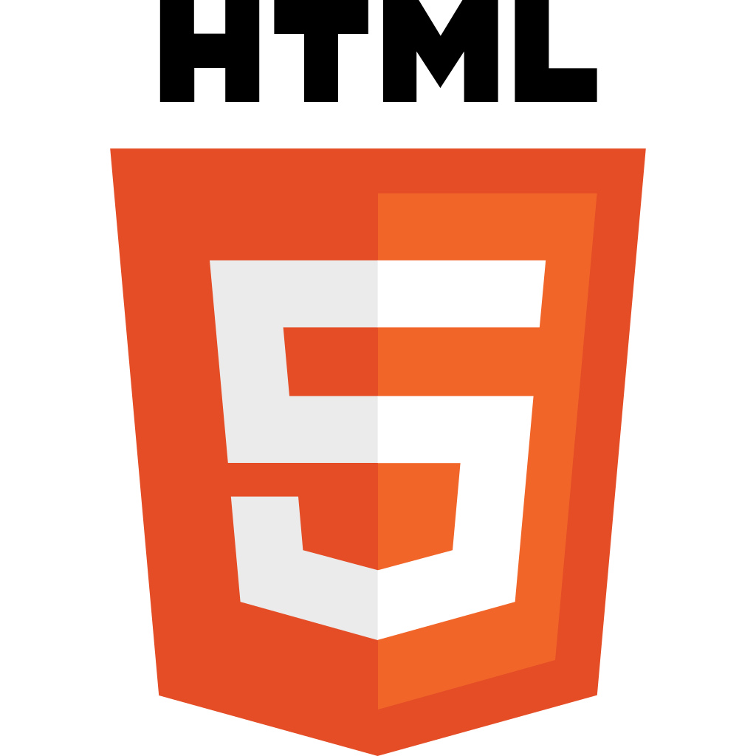
Front End Development
Web pages involve markup languages, which tells the browser how pages should be displayed
Markup languages determine the layout and design of web documents, they are not considered "programming languages"
The languages that make up websites are HTML, CSS, and JavaScript
HTML (Hypertext Markup Language), defines the elements (parts) of a webpage
Websites cannot exist without HTML as it is the content in a website

Slide 4

CSS (Cascading Style Sheets)
CSS is a style sheet language that changes how HTML elements should be presented by the browser
Basic elements of a webpage (text, lists, buttons) are coded in HTML
The style of elements (colour, size, location, font, etc.) is determined using CSS
Modifies pages to be readable on different devices, phone, laptop, etc.
CSS frameworks offer additional functionality and a set of premade styles to use: eg. Bootstrap, Foundation, Materialize, Blueprint, etc

Slide 5

JavaScript
JavaScript is a scripting language that programmatically changes the behaviour of web pages
One of the most popular and widely used languages, many frameworks use Javascript such as jQuery and AngularJS (Angular 1)
Node.js is a backend framework can be used to make web applications using Javascript (or Typescript)
Typescript is a superset of Javascript that supports the new es6 syntax and is "compiled" into Javascript when used

Slide 6
Back End Development
Back end development deals with unseen portion of web applications such as databases, hosting and other networking tasks
Back end skills include database management, back end frameworks, security
Back end languages include: Java, PHP, Ruby on Rails, Python, and .Net

Slide 7
Static vs Dynamic Websites
Static
Are the most common and require much less computational resources
The content does not change
Does not require a backend server
Dynamic
Can be used to host a static website
The content could change
Usually requires a dedicated backend server

Slide 8
Editing
All that you need to edit HTML is a text editor
Even Notepad can work (but it may be more difficult to use)
Common Editors for Web Dev: Atom, Sublime Text, VS Code
Online HTML editors: Very easy to use and get started with, see changes quickly
Tryit Editor v3.6
JSFiddle - Code Playground

Slide 9
Hosting a Website
Websites that are visited on the internet are all hosted on servers
Registering a domain is recommended, domain names remove the need to type the IP address of your web server and makes it easier to remember
Top level domains (.com, .net) are managed by ICANN
To register a domain name, people go through registrar companies like GoDaddy, Namecheap, Hover, Google Domains, etc.
Self-hosting websites is possible, most websites are run with hosting providers

Slide 10
Github Pages
Free option for statically hosting websites
Good for personal websites
Domain looks like: "yournamehere.github.io"
There is no setup for SSL
Could be enabled in your repository settings and integrates well with Github
They only host static websites, though static websites could be made to seem dynamic

Slide 11
Links
https://www.w3schools.com/
https://jsfiddle.net/
https://pages.github.com/

